Slide 1

Wi-Fi extender :
Extending your network reach

Slide 2

Agenda
INTRODUCTION
PROBLEM STATEMENT & SOLUTION
WHAT IS ESP32 WI-FI EXTENDER?
BUILDING AN EXTENDER-STEPS
MARKET TRENDS &COST ANALYSIS
CONCLUSION
REFERENCE

Slide 3

INTRODUCTION
THE PROJECT
An ESP32 Wi-Fi extender is a mini project that allows you to extend the range of your existing Wi-Fi network using an ESP32 microcontroller.
This can be a great solution if you have areas in your home or office where the Wi-Fi signal is weak or nonexistent.

Slide 4
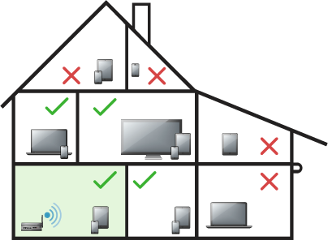
PROBLEM STATEMENT:
Weak or nonexistent Wi-Fi signal in certain areas of your home or office.
SOLUTION:
ESP32 Wi-Fi extender
BENEFITS:
Extend Wi-Fi range: Increase coverage area
Low cost: Affordable alternative to commercial extenders
Customizable: Configure settings and features

Slide 5

WHAT IS AN ESP 32 WI-FI EXTENDER ?
Let’s Dive In

Slide 6
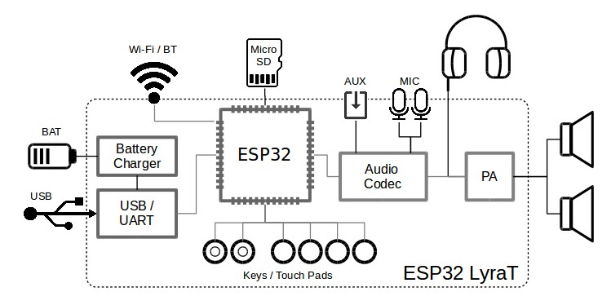
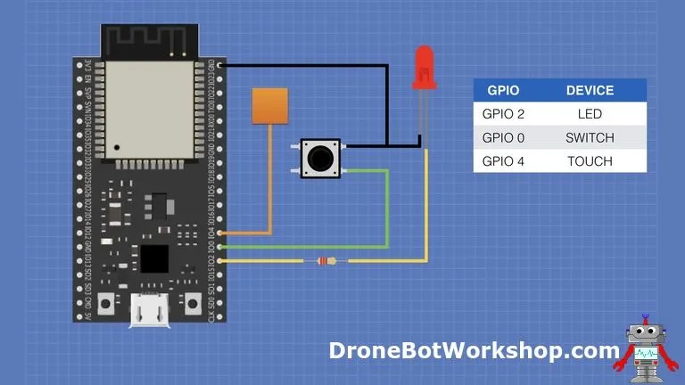
Esp 32 extender:
The ESP32 Wi-Fi Extender acts as a bridge between your existing Wi-Fi network and your devices.
Connection to Existing Network: The ESP32 connects to your existing Wi-Fi network as a client, just like any other device. It receives the internet signal from your router.
Signal Amplification and Retransmission: The ESP32 amplifies the received signal and retransmits it, creating a new access point with its own SSID and password.
Device Connection: Your devices can then connect to the ESP32's Wi-Fi access point, gaining access to the internet through the extended network.

Slide 7
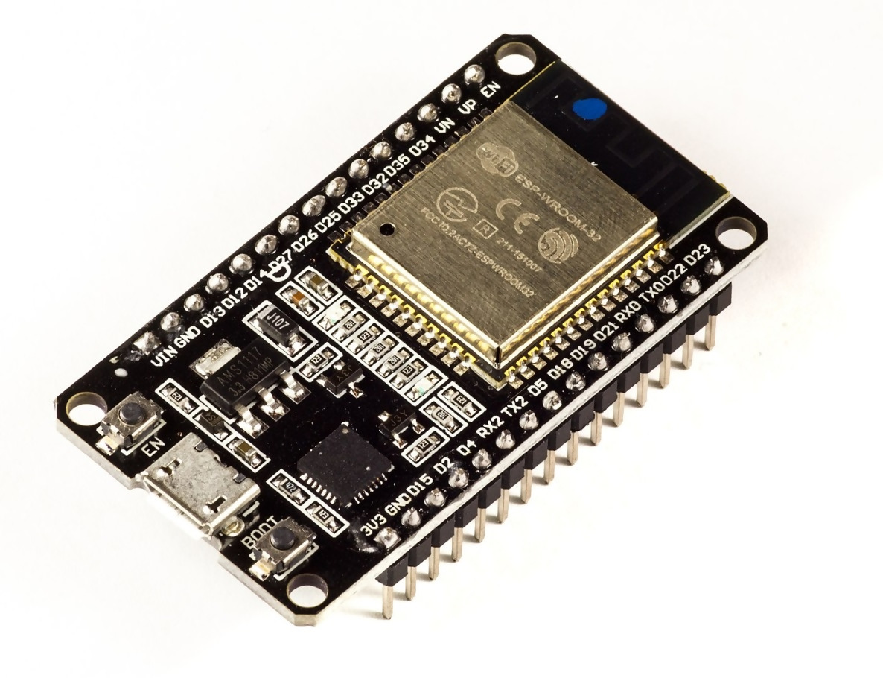
BUILDING AN EXTENDER..
WHAT YOU NEED:
ESP32 board
Micro-USB cable
Power adapter (optional)
Windows PC
Flash Download Tool (downloadable from Espressif website)
ESP32 NAT Router firmware (download from GitHub)

Slide 8
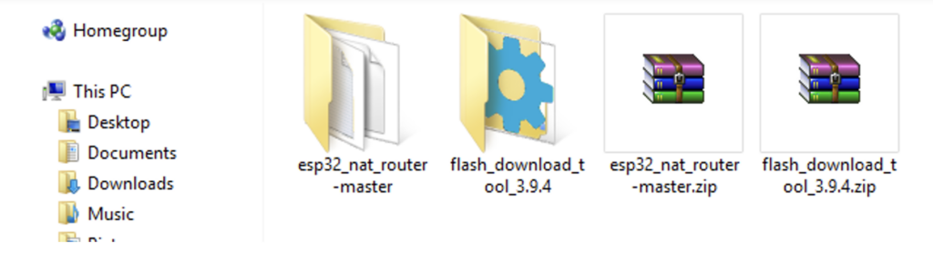
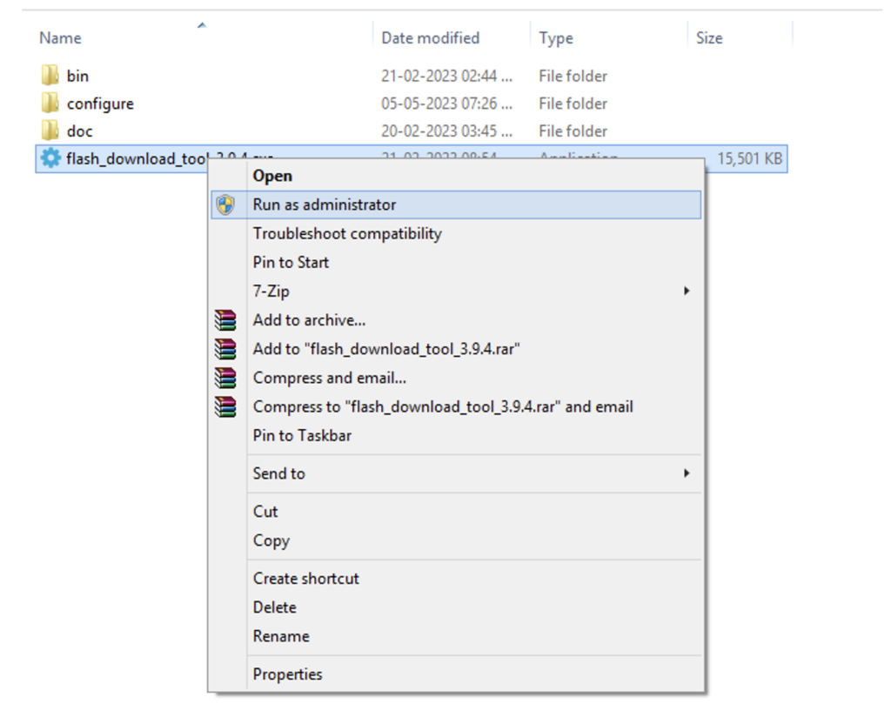
STEPS:
Step 1: Download the Tools and Firmware
Install the ESP Flash Download Tool on your PC.
Download the ESP32 NAT Router firmware from GitHub.
Unzip both files on your PC.

Slide 9
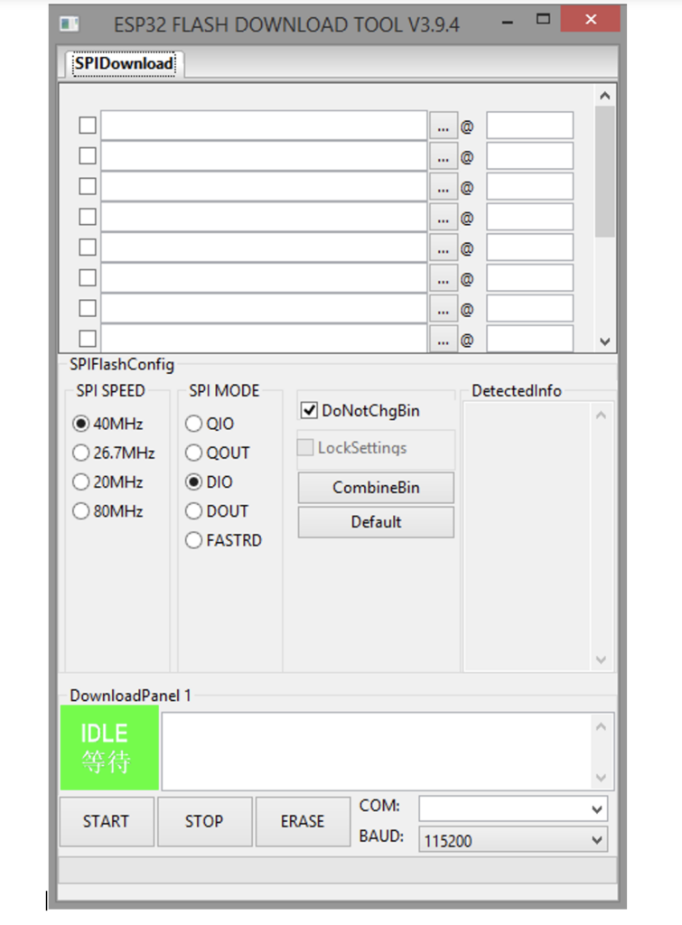
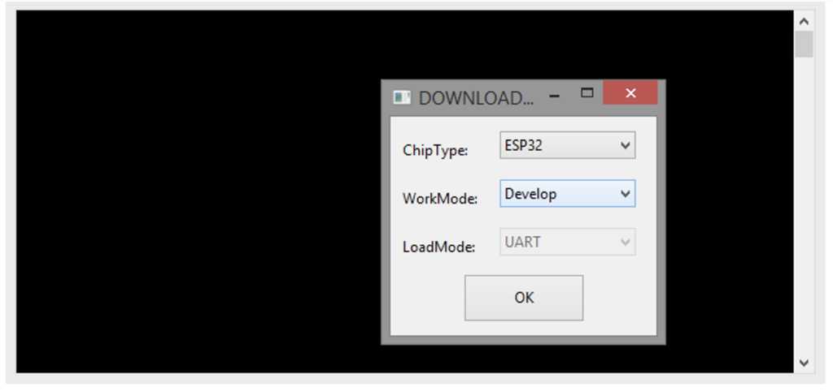
Step 2: Upload the Firmware to ESP32
Run the Flash Download Tool as administrator.
Choose "ESP32" Chip Type and "Develop" WorkMode.
Browse and load bootloader.bin, firmware.bin, and partitions.bin files.
Assign hex codes: 0x1000 for bootloader.bin, 0x10000 for firmware.bin, and 0x8000 for partitions.bin.
Connect ESP32 to your PC and select the COM port.
Change BAUD rate to 576000 bps.
Press the ESP32 boot button and click "START".
Once the firmware is uploaded, release the boot button and unplug/replug the ESP32 board.

Slide 10
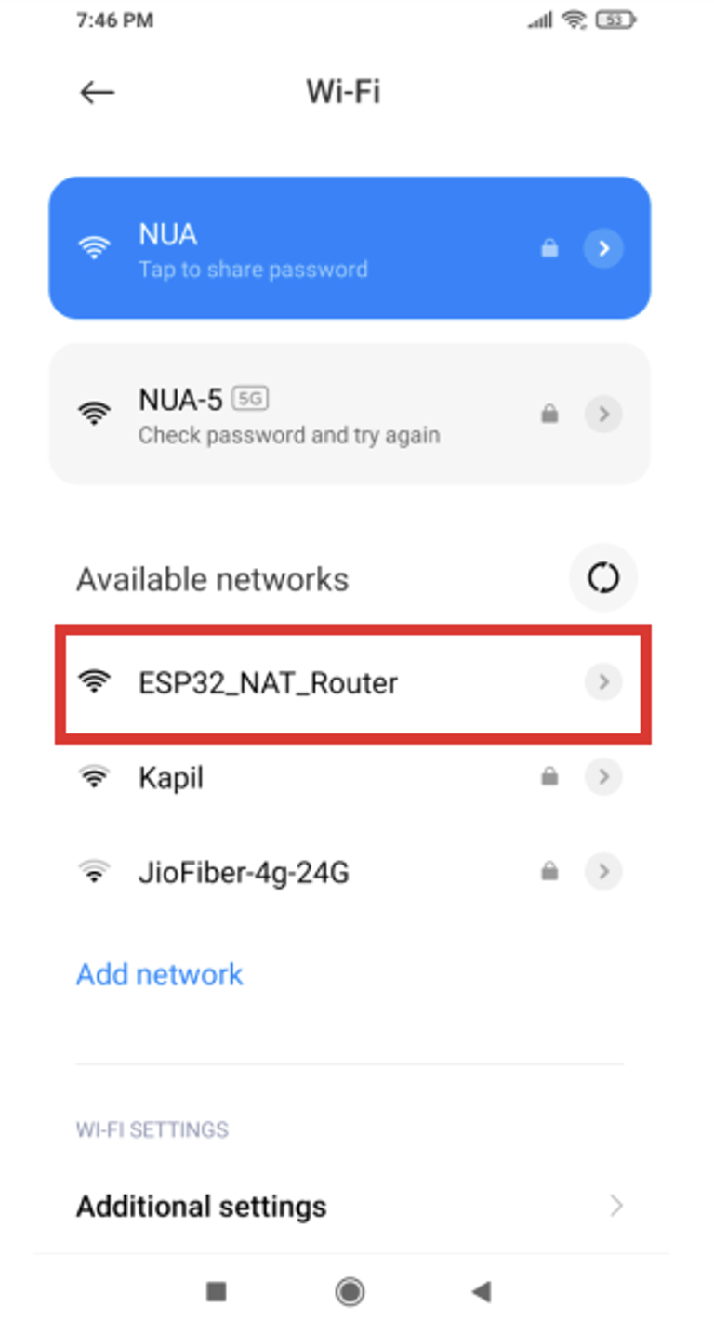
Step 3: Configure the Wi-Fi Repeater
Connect to the "ESP32_NAT_Router" network from your device.
Open a browser and enter "http://192.168.4.1".
Under "STA Settings", enter the SSID and password of your existing Wi-Fi network and click "Connect".
Under "AP Settings", set the desired SSID and password for the ESP32 NAT router and click "Set".
Restart the ESP32 board.

Slide 11

MARKET TRENDS &COST ANALYSIS
LOOKING AHEAD

Slide 12
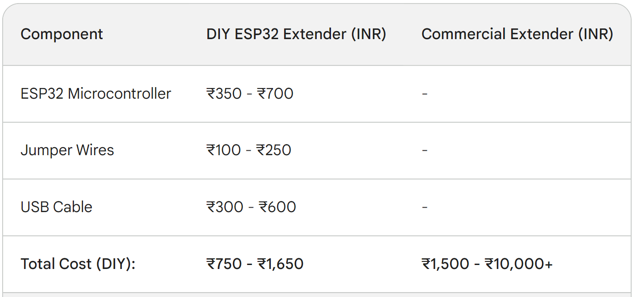
Cost analysis
ESP 32 EXTENDER V/S COMMERCIAL OPTIONS

Slide 13
MARKET TRENDS
Key Drivers:
Cost-effectiveness: Affordable alternative to commercial solutions, accessible to a wider audience.
Customizability & Open-source: Tailoring features and accessing free code fosters innovation and individual solutions.
Technological Advancements: Mesh networking, increased range, and smart home integration enhance user experience.
Opportunities & Challenges:
Market Penetration: Raising awareness and providing user-friendly solutions can attract a wider audience.
Competition: Differentiation and continuous innovation needed to compete with established manufacturers.
Technical Hurdles: Simplifying the building process and offering technical support can encourage more users.

Slide 14
CONCLUSION
With continued innovation and affordability, ESP32 Wi-Fi extenders are poised for even greater market penetration, empowering individuals and businesses to conquer dead zones and embrace the full potential of their internet access.

Slide 15

REFERENCE:
ESP Flash Download Tool: https://dl.espressif.com/dl/esp-idf/
ESP32 NAT Router firmware: https://github.com/martin-ger/esp_wifi_repeater
https://www.engineersgarage.com/esp32-portable-wifi-repeater/
Video: https://www.youtube.com/watch?v=azVWEIlmR3Y

Slide 16
Members:
Nandana Shibu
Anusree Pradeep
Arunima Sudheer
Bhadra J R
Gopika S Dhilip
Sandhya M
THANK YOU.

